Slide 1
INJECTION TECHNIQUES VIDEOS
BY
DR.G.AARTHIPRIYANKA
POST GRADUATE
DEPARTMENT OF PHARMACOLOGY

Slide 2

INTRAVENOUS INJECTION

Slide 3

Z TRACT TECHNIQUE

Slide 4
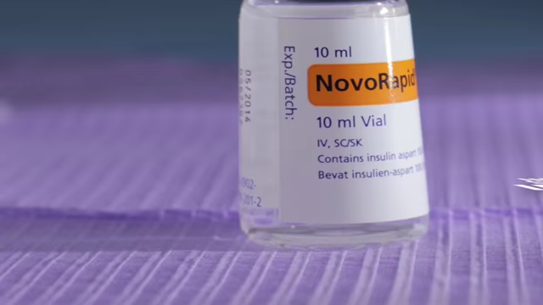
SUBCUTANEOUS INJECTION

Slide 5

INTRAMASCULAR INJECTION

Slide 6

INTRADERMAL INJECTION

